Slide 1
Circular Keys Chorus
2017 Membership Drive – Marketing Plan
Discover the World of Harmony

Slide 2
Who are potential new members?
Here’s a snapshot:
According to the 2016 census, the typical Australian is a 38 year old married mum of two. She lives in a three-bedroom home, does up to 14 hours of housework a week, has two cars and finished year 12.
Median age of a woman in Greater Sydney is 37.8

Slide 3
Who are potential new members?
Some interesting facts from the NSW Department of Community and Family Services publication, Women in NSW
NSW women are less likely to rate their health positively and they engage in lower levels of physical activity than their male counterparts. Women engage in healthy behaviours more often than men (e.g. fewer smokers, drink less and are more weight conscious).
BENEFIT OF BELONGING TO CKC : SINGING IS GOOD FOR YOUR HEALTH
Lone mother families comprise 13.5% of all families and there is an increasing trend for women living alone.
BENEFIT OF BELONGING TO CKC: CONNECTEDNESS AND COMMUNITY
When it comes to working in the home, women continue to shoulder the burden of unpaid household work, spending an average of 13 hours more than men per week on household duties.
BENEFIT OF BELONGING TO CKC: THE OPPORTUNITY TO DO SOMETHING JUST FOR YOURSELF

Slide 4
Who are potential new members?
The percentage of women with qualifications at Certificate III and above has increased by 20 percentage points since 2001, to 57.5 percent of all NSW women in 2013. This is a faster rate of growth than among men. Today, NSW women have fewer formal qualifications than men only in the 45 and older age groups.
BENEFIT OF BELONGING TO CKC : THE EDUCATION
Women feel the impact of the ‘double shift’ and reported high levels of time stress. Some 63 percent of women with dependent children who were working full-time reported feeling rushed or pressed for time ‘almost always’ or ‘often’.
BENEFIT OF BELONGING TO CKC: ALL OF THE ABOVE & SINGING REDUCES STRESS LEVELS

Slide 5
What our members say …
How did we hear about CKC/ How to recruit this time?
• Word of mouth, bring friends, business cards
• Performances and sing-outs
• Local Paper ad/ local proximity
• Radio
• Facebook, You-Tube and Internet
• Flyer at local shops, libraries, community noticeboards, on mirrors and on back of toilet doors, in letterboxes
• Friends already in Sweet Adelines
• In member car windows

Slide 6
What our members say …
What was the attraction of CKC?
• Appreciation of Vicki – learning from a Master Director • Learning to sing properly • Musical Expertise • Great Reputation • No Contract • Safety in Numbers • Harmony/ singing again/ great to sing in a large group • Singing songs straight away • Music and jargon – challenging eg different meanings of “riser” • Name Tags great and members wearing T-shirts helped to distinguish them from the new recruits • Impressive organisation and professionally run • Welcoming and friendly Choreography • Involves weekends and daytime as well • Effective communication re program but perhaps the written material could be updated. • Meeting new people • Singing with family • Downtime – relaxing and provides a buzz • End of Course Performance opportunity

Slide 7
Marketing Campaign
Based on the information presented, a six week marketing campaign is proposed, starting 1st July, focussing on local media, social media, flyer distribution and word of mouth.
There will be weekly focus stories about selected members posted on social media. These stories will be the focus of the press releases sent to local media, mid-campaign.
Media Campaign
Press releases sent to local media, using the focus stories, w/c Monday 17th July, with follow-up phone calls.
Radio coverage - target ABC702, in particular, Simon Marnie’s show.
What’s On Listings
Local newspapers, Gumtree, Council newsletters etc
Other, other, other

Slide 8
Press Release
Do you love to sing? Do you love to perform? Have you watched the movie Pitch Perfect and thought “I would love to sing like that?”.
Are you the first person to put your hand up for a karaoke night out? Or do you miss the days when you sang in the school choir?
Join Circular Keys Chorus at their six-week vocal workshop starting in August and learn to sing a cappella harmony.
We sing in four parts, so if you sing high, if you sing low or if you sing in between, there’s a place just for you.
Neuroscience proves singing makes us happier, healthier, smarter and more creative. Singing is also a great way to make friends and find a community to belong to.
[insert focus story]
Based in Baulkham Hills, Circular Keys Chorus has been enriching women’s lives for over 22 years with music, education and friendships.
They are part of the leading musical organisation for women, Sweet Adelines International (SAI) and are currently Australia’s small chorus champions. In 2018, members are looking forward to travelling to St. Louis to represent Australia, for the third time, at the SAI international competition.
For more information and to register for the six week vocal workshop – circularkeys.org

Slide 9
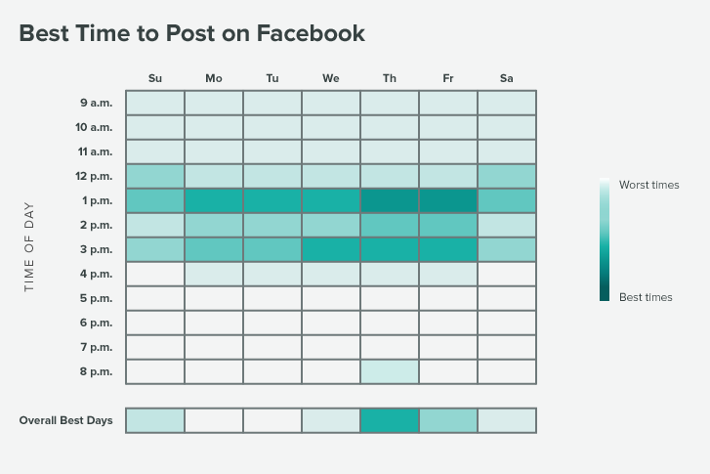
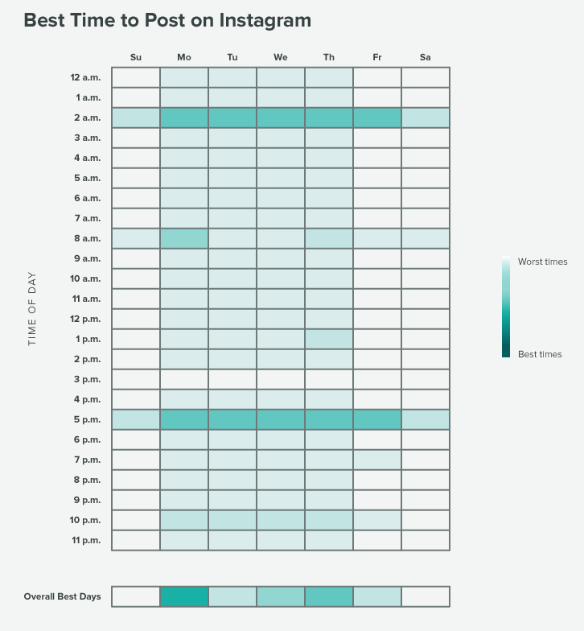
Social Media Campaign
Social Media Campaign – Facebook and Instagram
Weekly member story posts
Weekly post with question/statement/call to action
30 second clip from Lissa (still to be decided how best to use)
Four paid Facebook ads, targeting specific demographics
Posting on targeted community group Facebook pages using weekly stories (Carol Lutz)
Actively engage with Meet Up “members” (Rachael Moessis)
Instagram posts – 5pm Monday & 9am Thursday
As at March 2017
Facebook posts:
1pm Thursday & 9am Sunday
As at March 2017

Slide 10
Social Media Campaign
WEEK ONE
Focus: The chorus.
Do you love to sing? Do you love to perform? Join Circular Keys Chorus at their six-week vocal workshop starting in August and learn to sing a cappella in four-part harmony.

Slide 11
Social Media Campaign
WEEK TWO
Focus: Heather Target area for press release: Parramatta
Story: Are you the first person to put your hand up for a karaoke night out? Or do you miss the days when you sang in the school choir or performing with your local musical society? Rediscover your inner diva and join Circular Keys Chorus at their six-week vocal workshop starting in August.

Slide 12
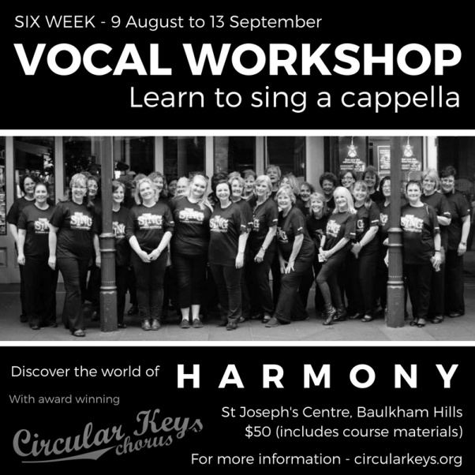
Social Media Campaign
WEEK THREE
Focus: Vicki & Kaitlyn Target area for press release: Blacktown & Rouse Hill
Story: Have you watched the movie Pitch Perfect and thought “I would love to learn how to sing like that?”. Join Circular Keys Chorus at their six-week vocal workshop starting in August. We sing in four parts, so if you sing high, if you sing low or if you sing in between, there’s a place just for you and we’ll teach you how.

Slide 13
Social Media Campaign
WEEK FOUR
Focus: Linda V. Target area for press release: Northern Districts
Story: Are you feeling stressed from a busy life, looking after everyone else except you? Have you thought about doing something good for your health and for your own happiness? Come along to our vocal workshop and discover just how good singing is for YOU!

Slide 14
Social Media Campaign
WEEK FIVE
Focus: Kumi Target area for press release: Hills Shire
Story: Are you looking for somewhere to meet people, make friends and find a community to belong to? At Circular Keys Chorus, we are women from all walks of life who share the joy of singing. Our members will tell you, “it’s the singing, it’s the friendships and it’s the support” that is so wonderful about belonging to CKC.

Slide 15
Social Media Campaign
WEEK SIX
Focus: Madee Target area for press release: North Shore
Story: Looking for something new to do? Tired of spending all your life working or studying? What about singing? We all do it, don’t we? In the shower, the car, when no one is listening? Come along to our vocal workshop and discover if singing harmony is what you’ve always wanted to do.

Slide 16
Local Community Engagement
Hills Shire / Parramatta / Blacktown
Distribution of flyers – shopping centres, business precincts, letterbox drop
Three area “leaders” have signed up to assist
Notices in school newsletters and performing art schools
Print run – 5,000

Slide 17
How to help our members share the word …
Encourage and remind members to carry and distribute business cards.
Make flyers available and ensure social media is in a format that can be easily shared with friends, family and colleagues.
Share the information with our members about who we see as potential new members, so they have an understanding of our marketing campaign. Run through with them the key messages of the campaign and how the benefits of belonging to CKC tie in.
Provide them with cheat sheets outlining our “elevator pitch” information.

Slide 18
Membership Drive Marketing Budget
Marketing Budget
A5 Flyers x 5000 - $250.00
Four Facebook ads - +-$440 .00

